Slide 1
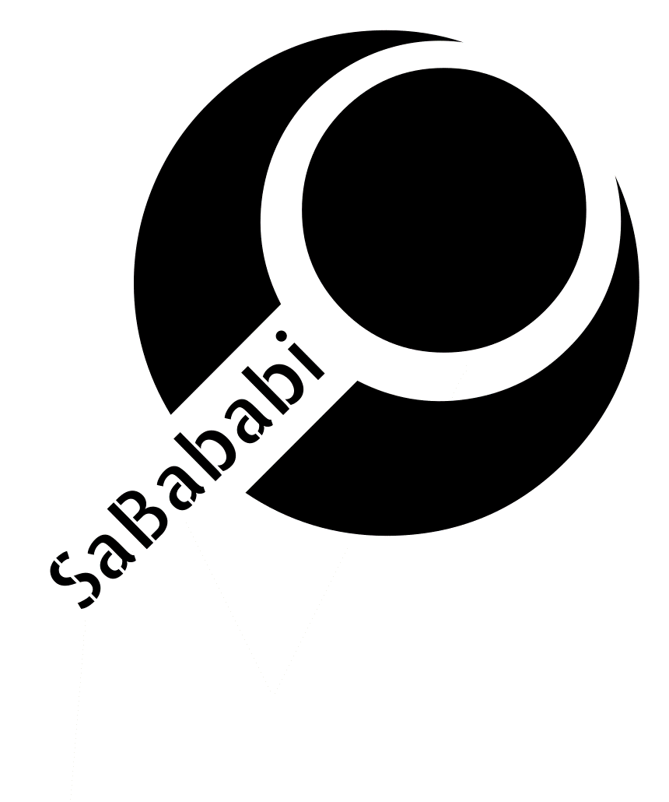
Sababi Project
Gal Bachar Shahar Baba Eden Meshulam Daniel George
Lecturer: Tal Gomay

Slide 2
The Project
Today, there is a high demand and many fundraisers of resources for all types of jobs and for high-tech in particular. Almost every company is looking for employees, and also there are lot of private people or freelancers that looking for full time job or part time job. The market today is difficult, and it is hard to find a candidate that fit the requirements of the company, so there is a high need to look candidates.

Slide 3
Client

Slide 4
Views
In our project we have four main views (Main screen, Chat, Notification and Menu). Some of these views contains another screens using React navigation (Main screen, Chat and Menu).
In each view we used different components.

Slide 5
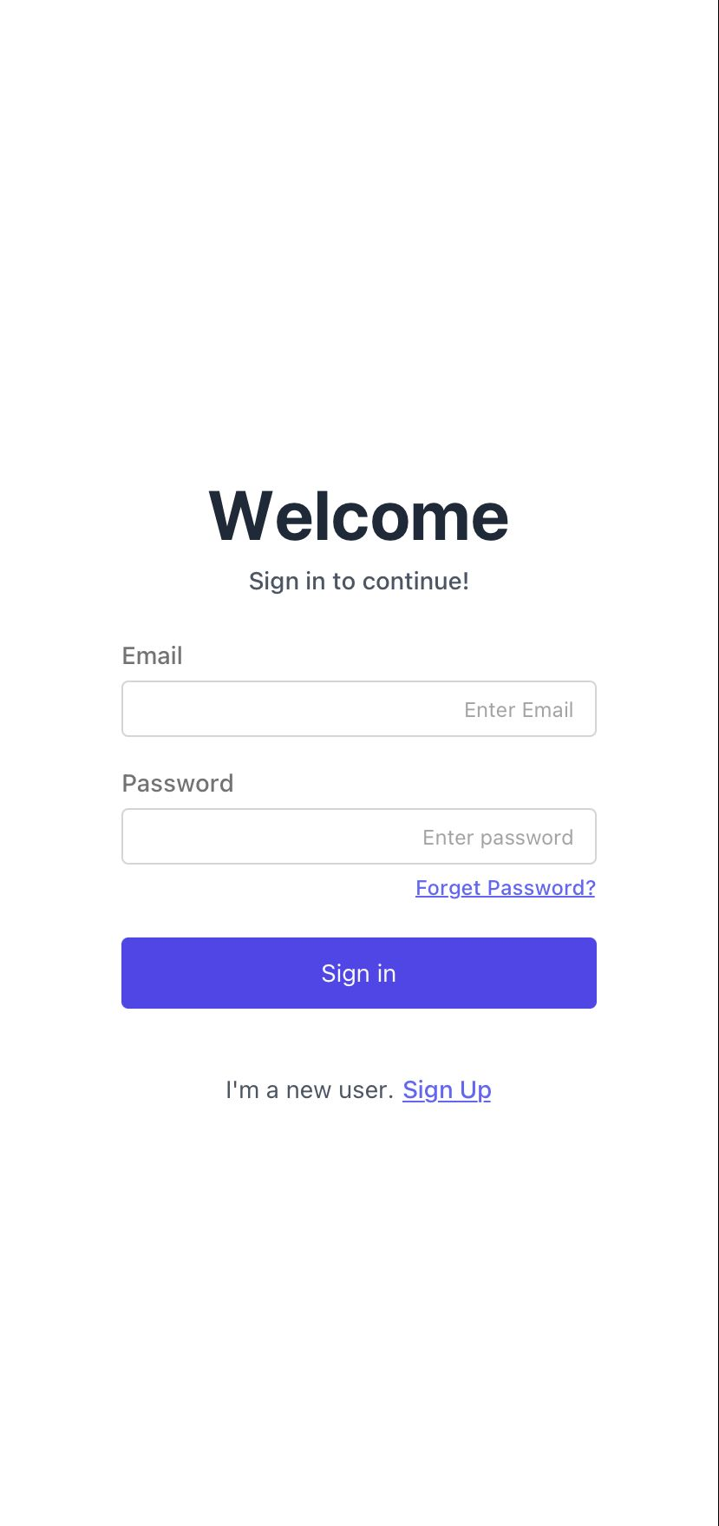
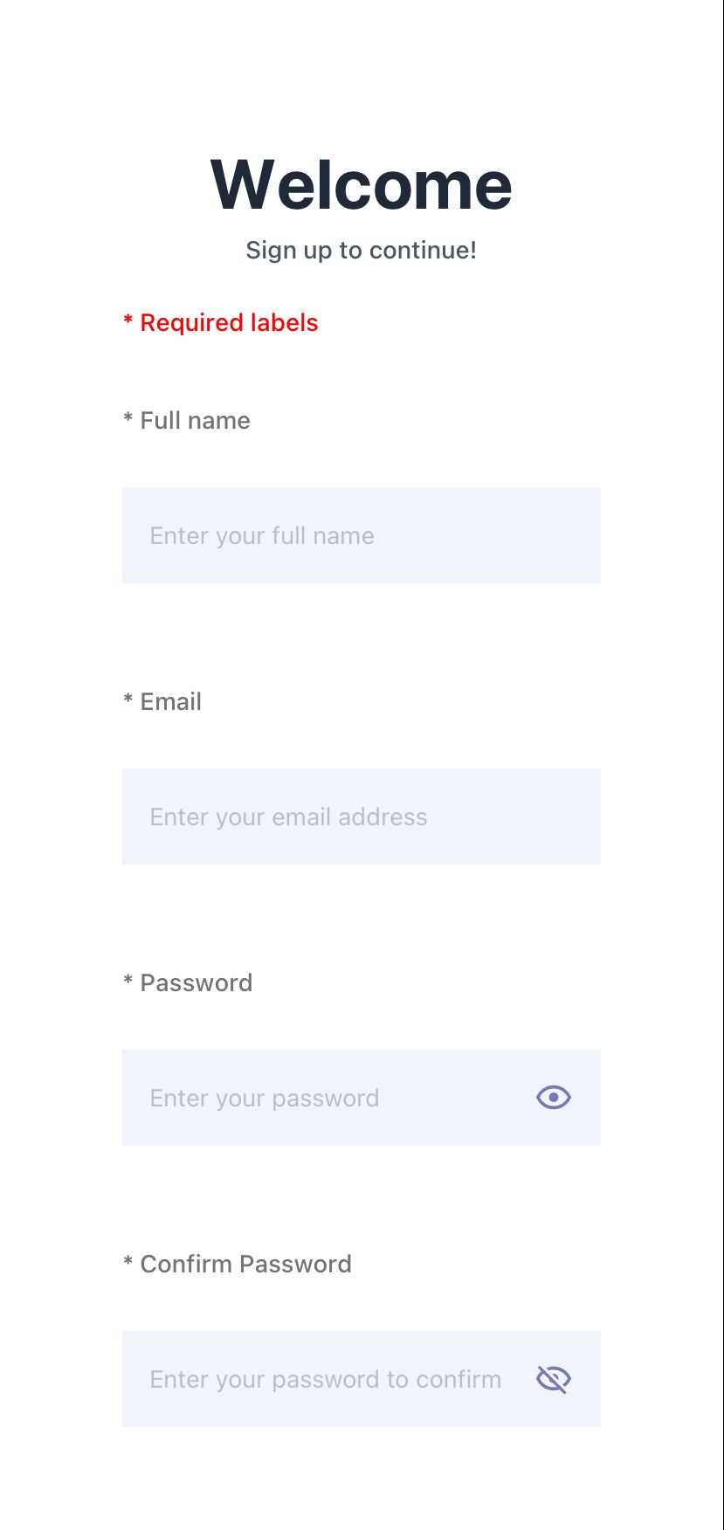
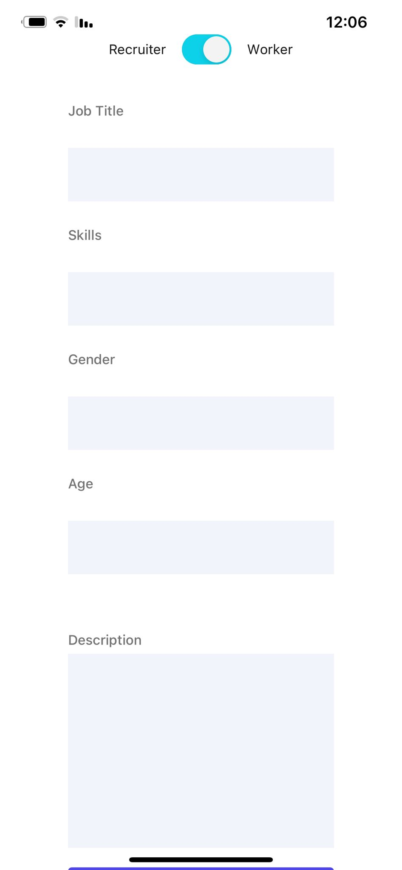
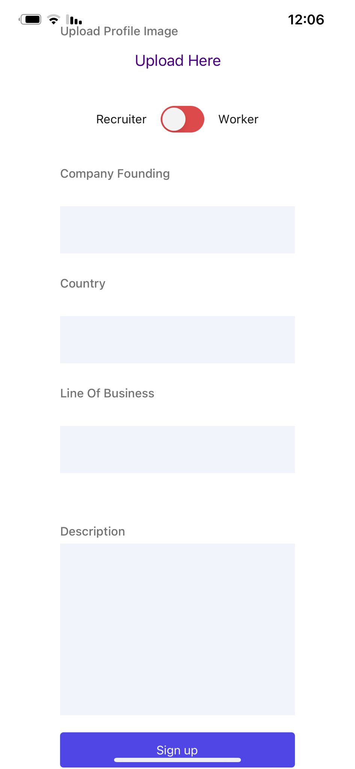
Views

Slide 6
Components
Our project contains some different components. We used components in different places of our project in order to display to the user different types of data. For example in the main screen we display adds, the adds need to be display differently for different types of users. If the user search job the main screen display job adds , but if the user type is provider the main screen display workers adds.

Slide 7
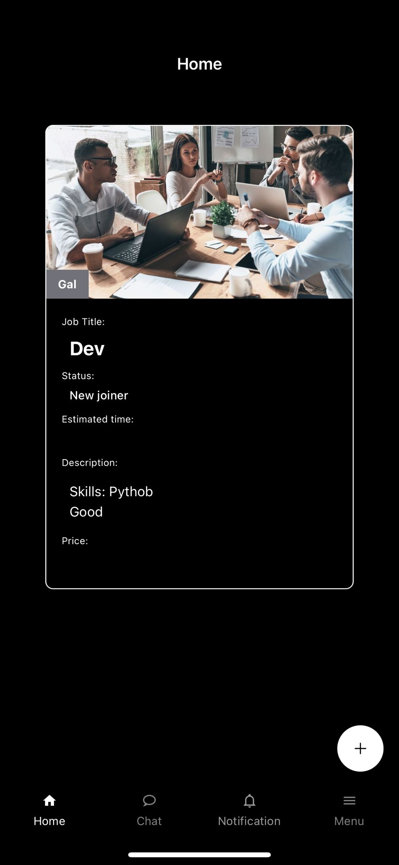
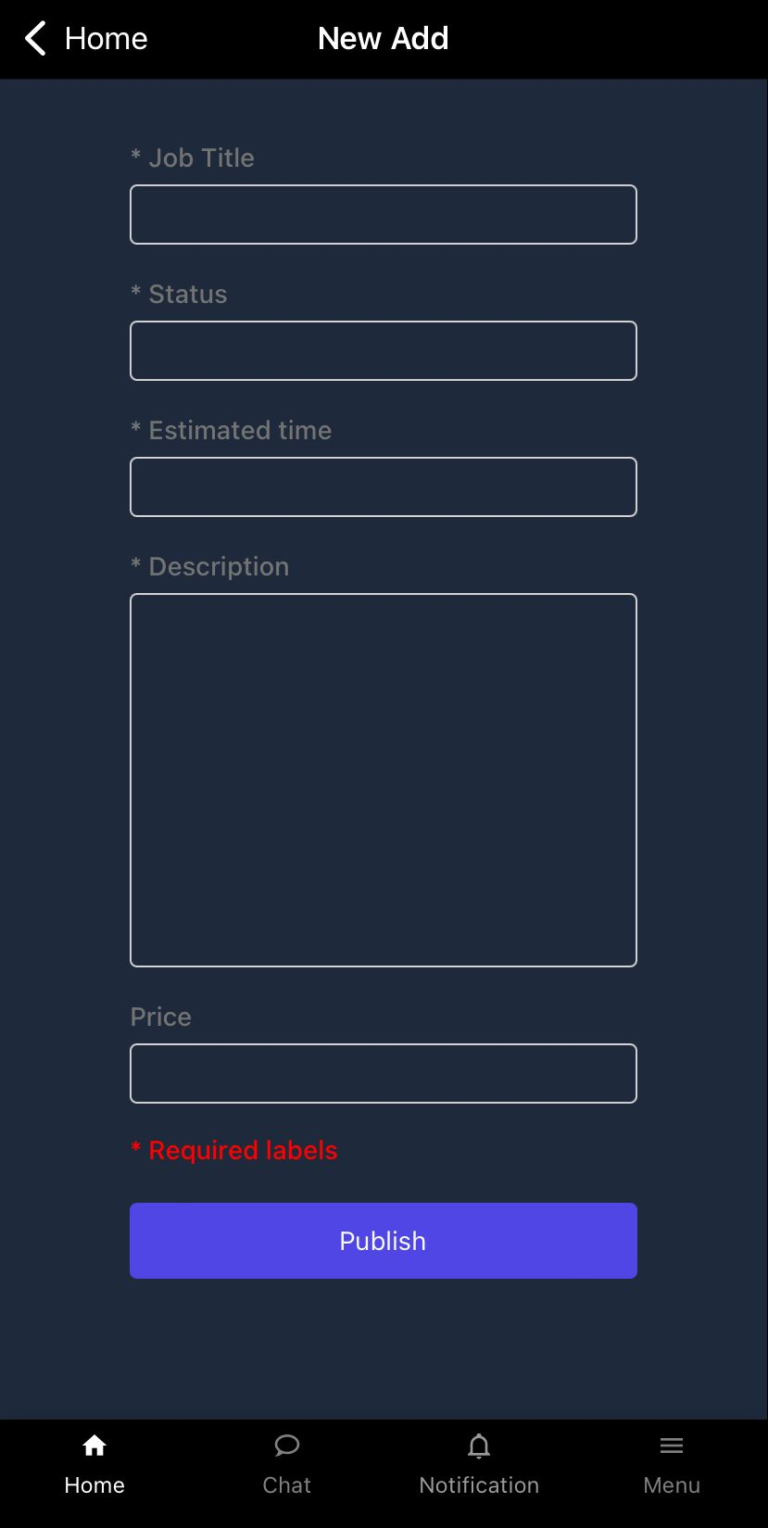
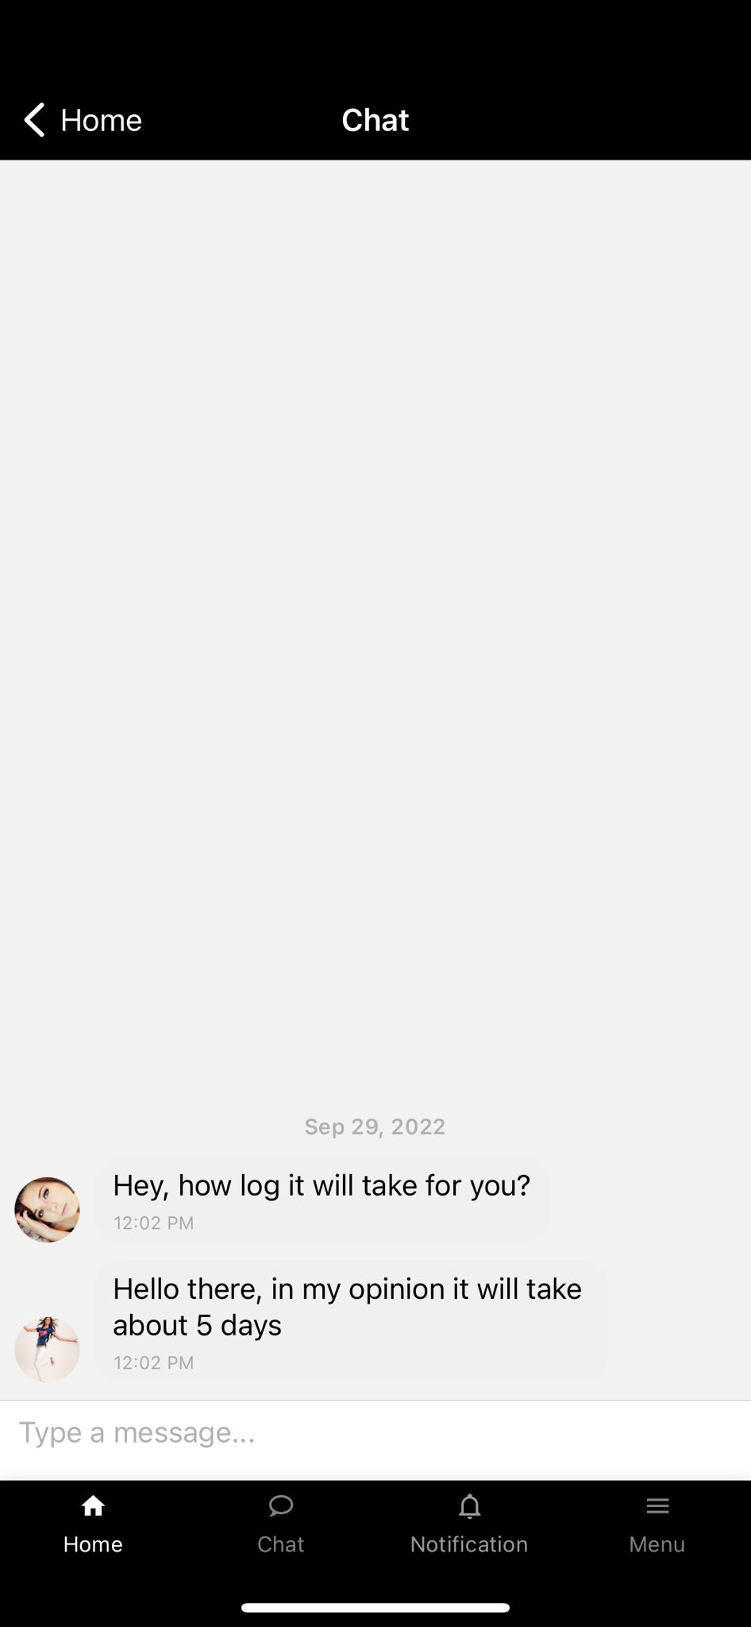
Components

Slide 8
Server

Slide 9
Technologies
Flask - Flask is a web framework written in Python.
It is classified as a microframework because it does not require particular tools or libraries. It has no database abstraction layer, form validation, or any other components where pre-existing third-party libraries provide common functions. However, Flask supports extensions that can add application features as if they were implemented in Flask itself. Extensions exist for object-relational mappers, form validation, upload handling, various open authentication technologies and several common framework related tools

Slide 10
SQL alchemy - SQLAlchemy is the Python SQL toolkit and Object Relational Mapper that gives application developers the full power and flexibility of SQL.
It provides a full suite of well known enterprise-level persistence patterns, designed for efficient and high-performing database access, adapted into a simple and Pythonic domain language.
Docker - We decided to run our server on Docker environment in order to achieve maximum flexibility, scalability and best practice of development.
Each developer should have only Docker on his private PC and he doesn’t need to install any packages, add-ons or files, in addition all the developers has the same environment as Production environment so we solve compatibilities issue in the future

Slide 11
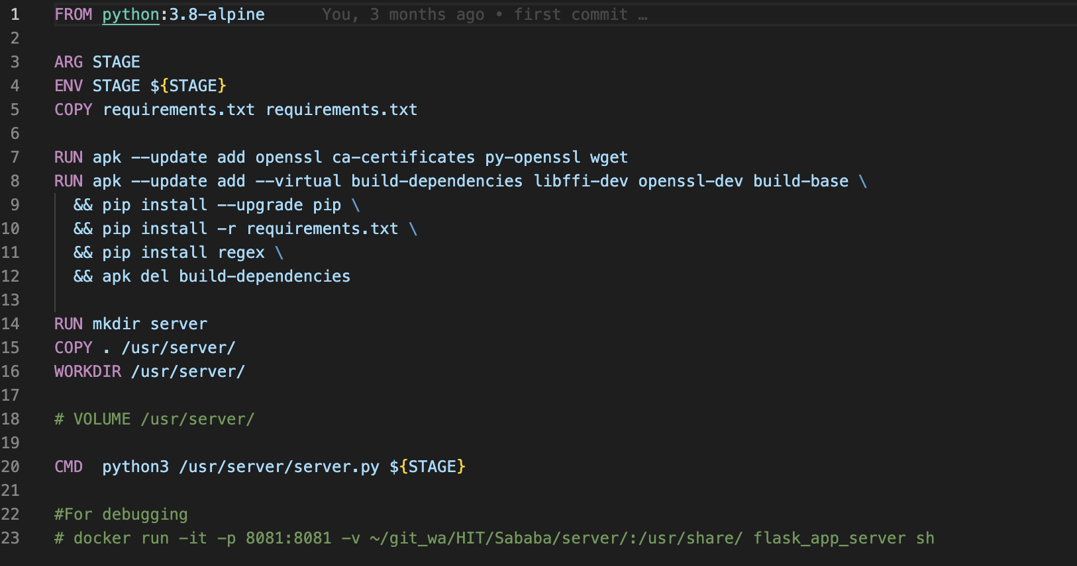
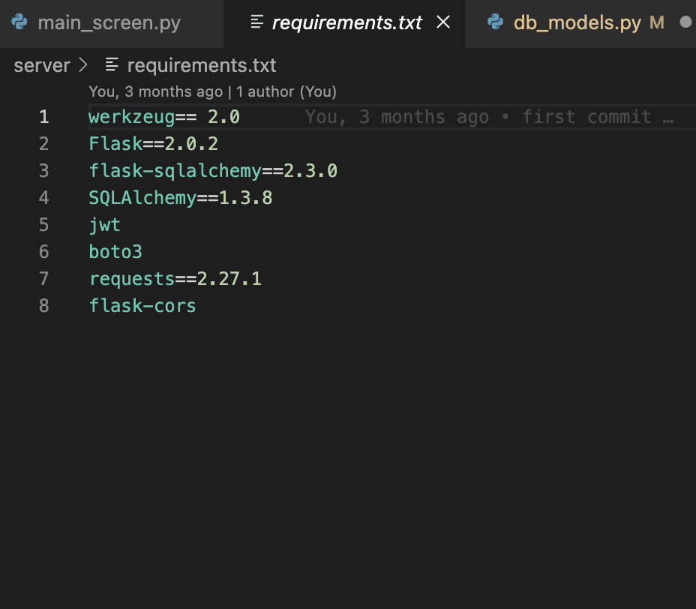
Technologies

Slide 12
Server architecture
Our server is devide to three main parts:
Database models
Routes
API’s

Slide 13
Database models
Definitions of all DB tables by using Flask-SQLAlchemy lib.
Each table has a class with its features and relevant methods.
In order to send data beween the server and client we implemented a “convering to dictionary” function which returns object that can be parsed as JSON in the client side.

Slide 14
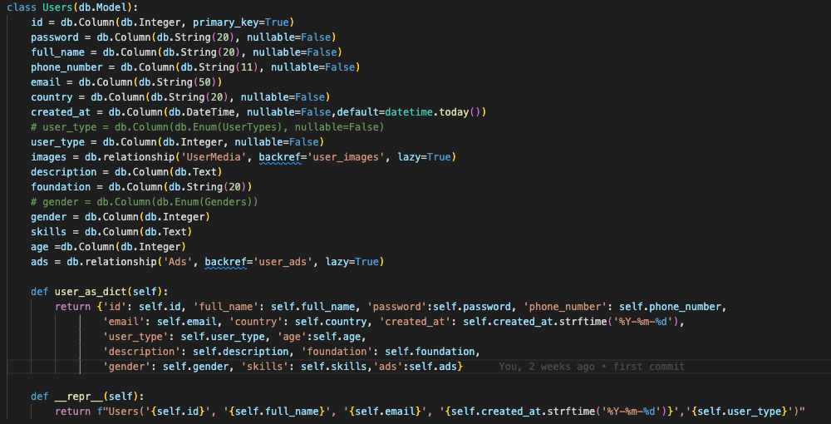
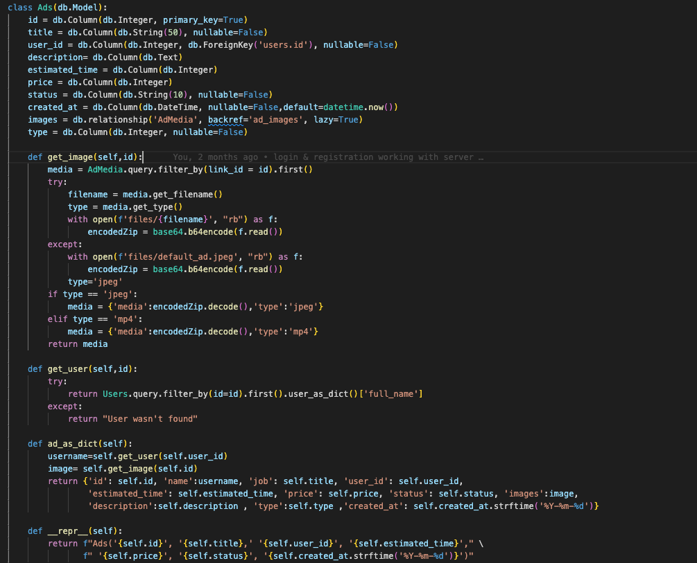
Queries Examples in FLASK-SQLAlchemy:
user = Users.query.filter_by(email=data['email'].lower()).first()
ads_query = Ads.query.filter(and_(Ads.id > last_ad, Ads.user_id != user_id)).limit(NUMBER_OF_ADS).all()

Slide 15
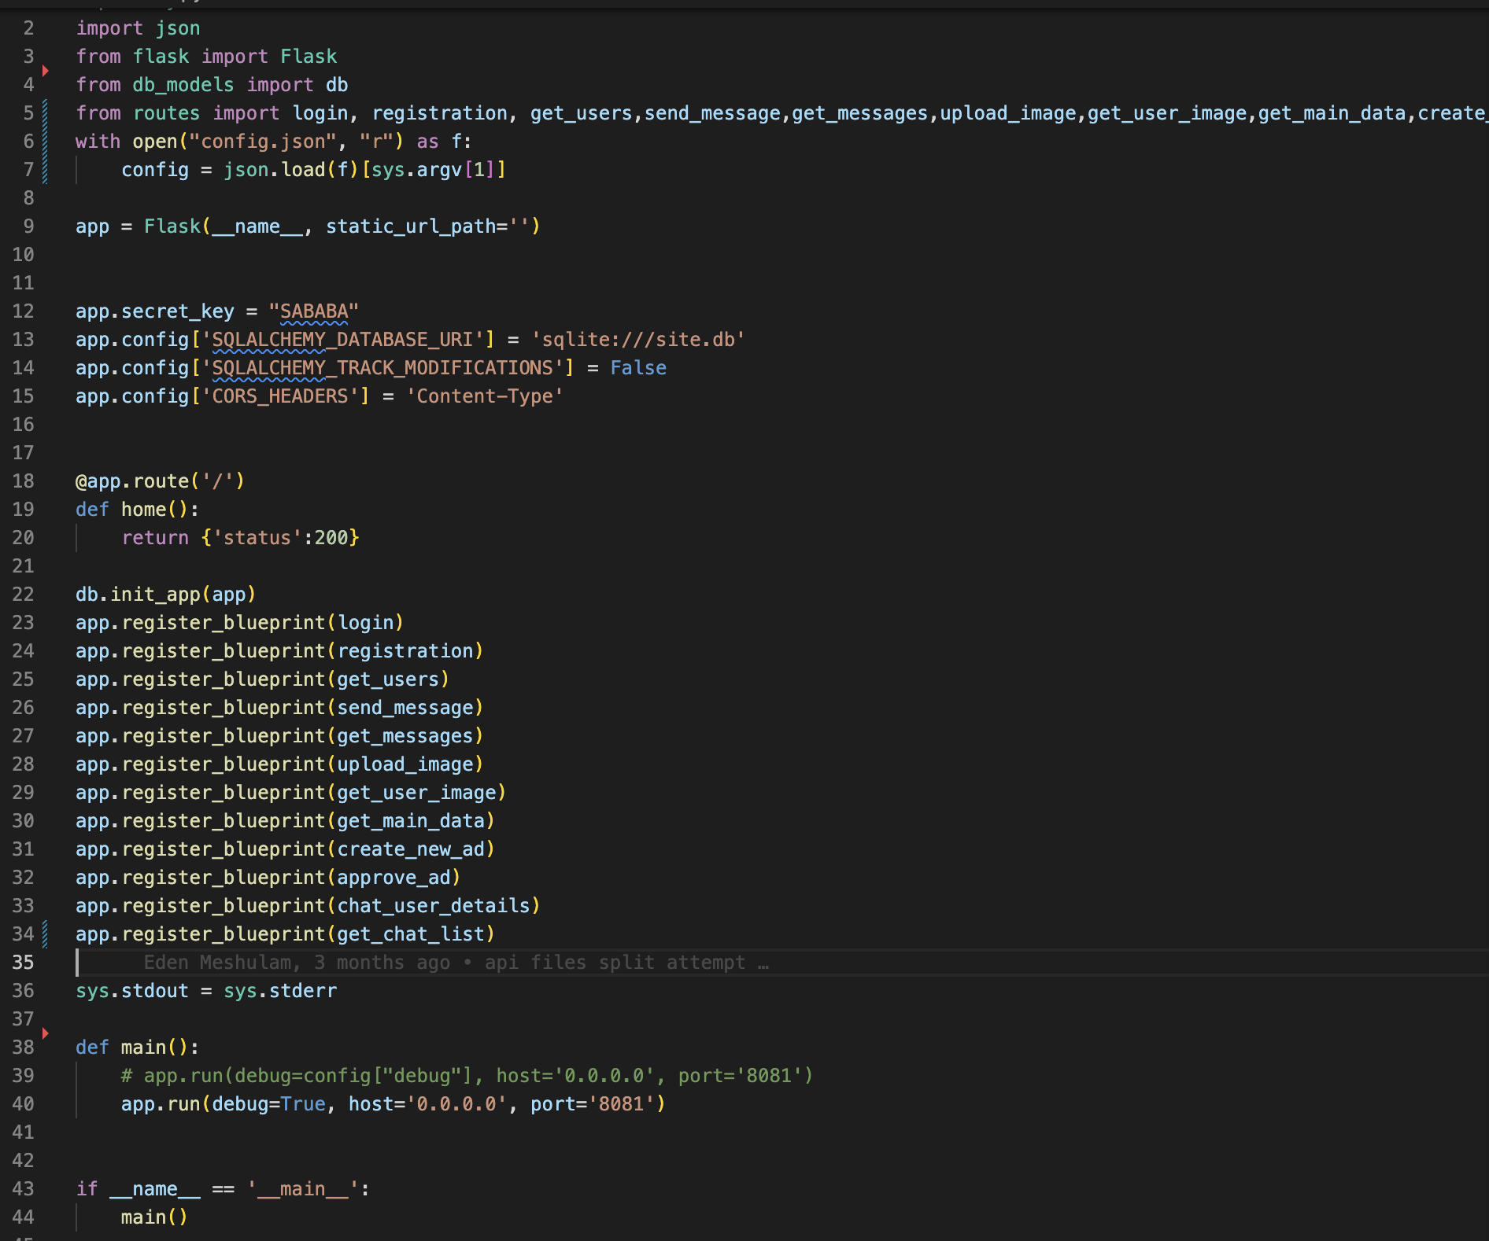
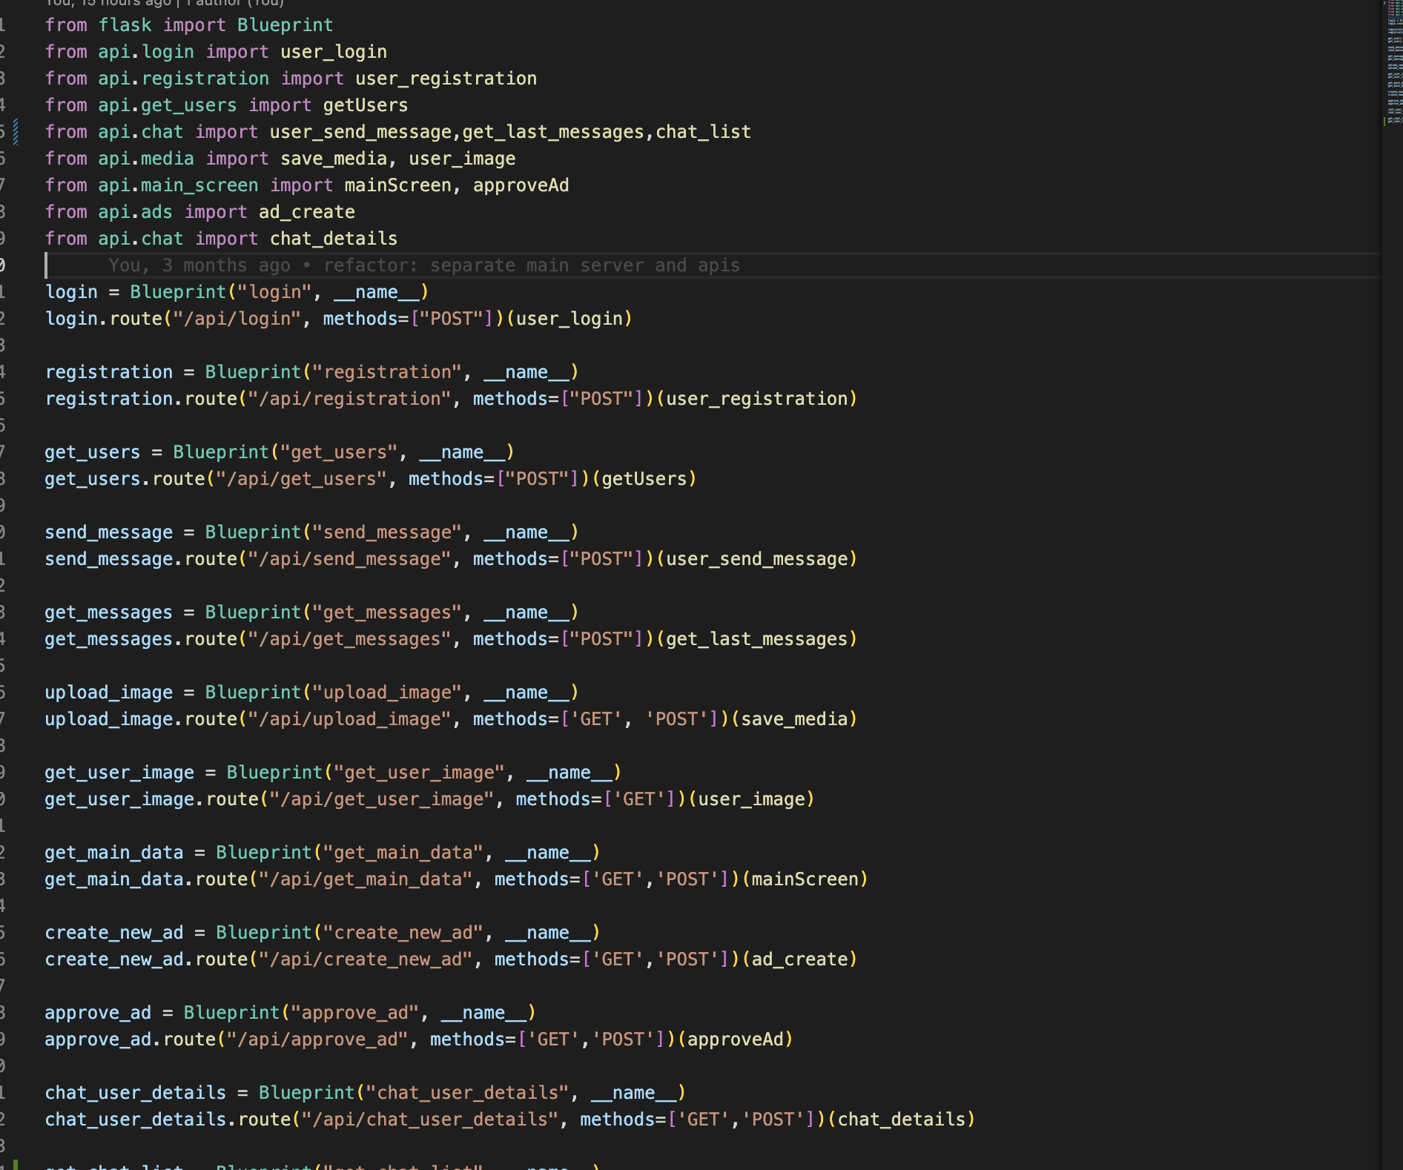
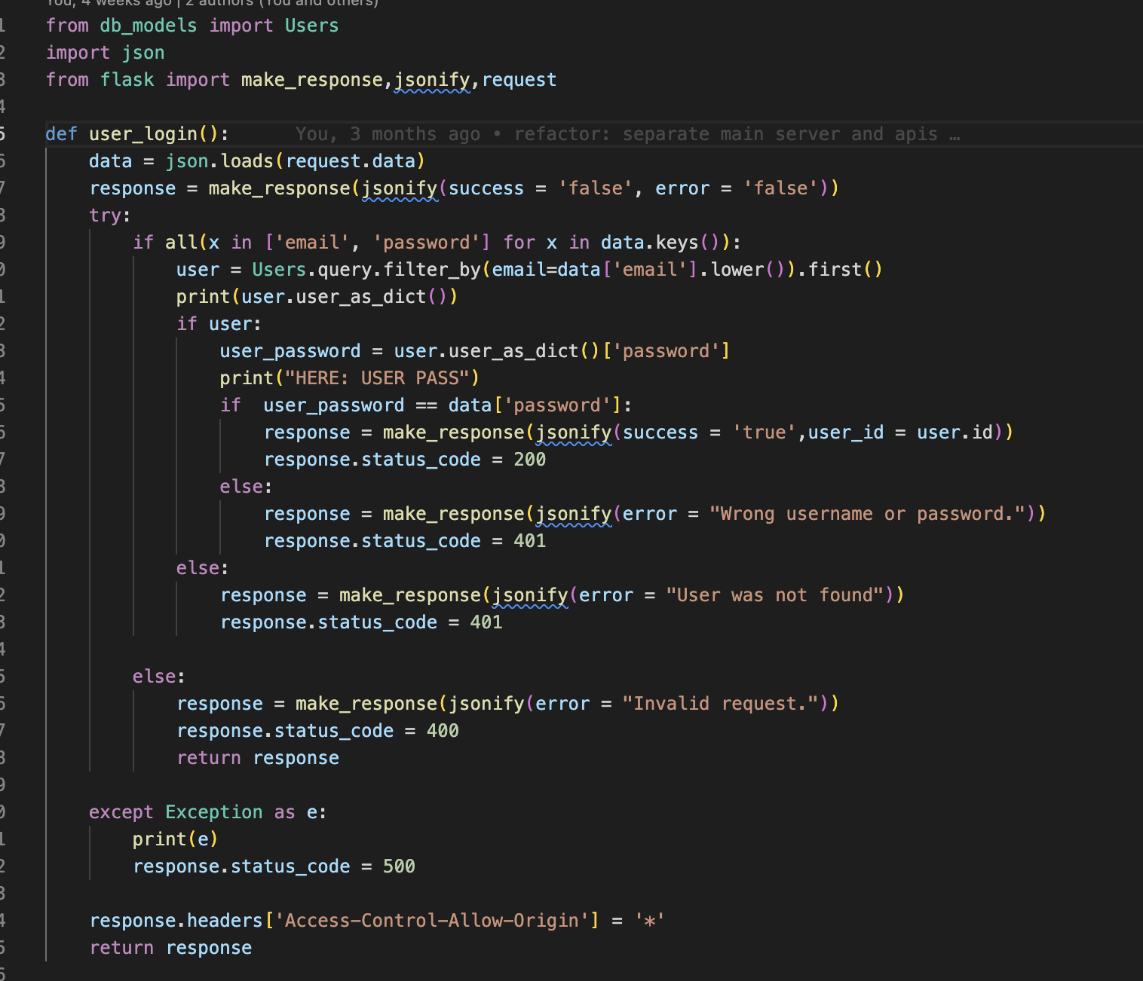
Routes
In order to establish API connections we are using Blueprint library.
Blueprint instead provide separation at the Flask level, share application config, and can change an application object as necessary with being registered.

Slide 16
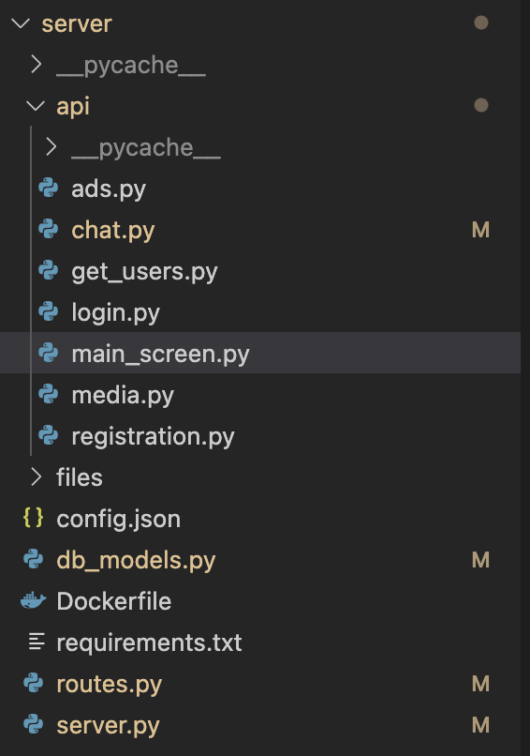
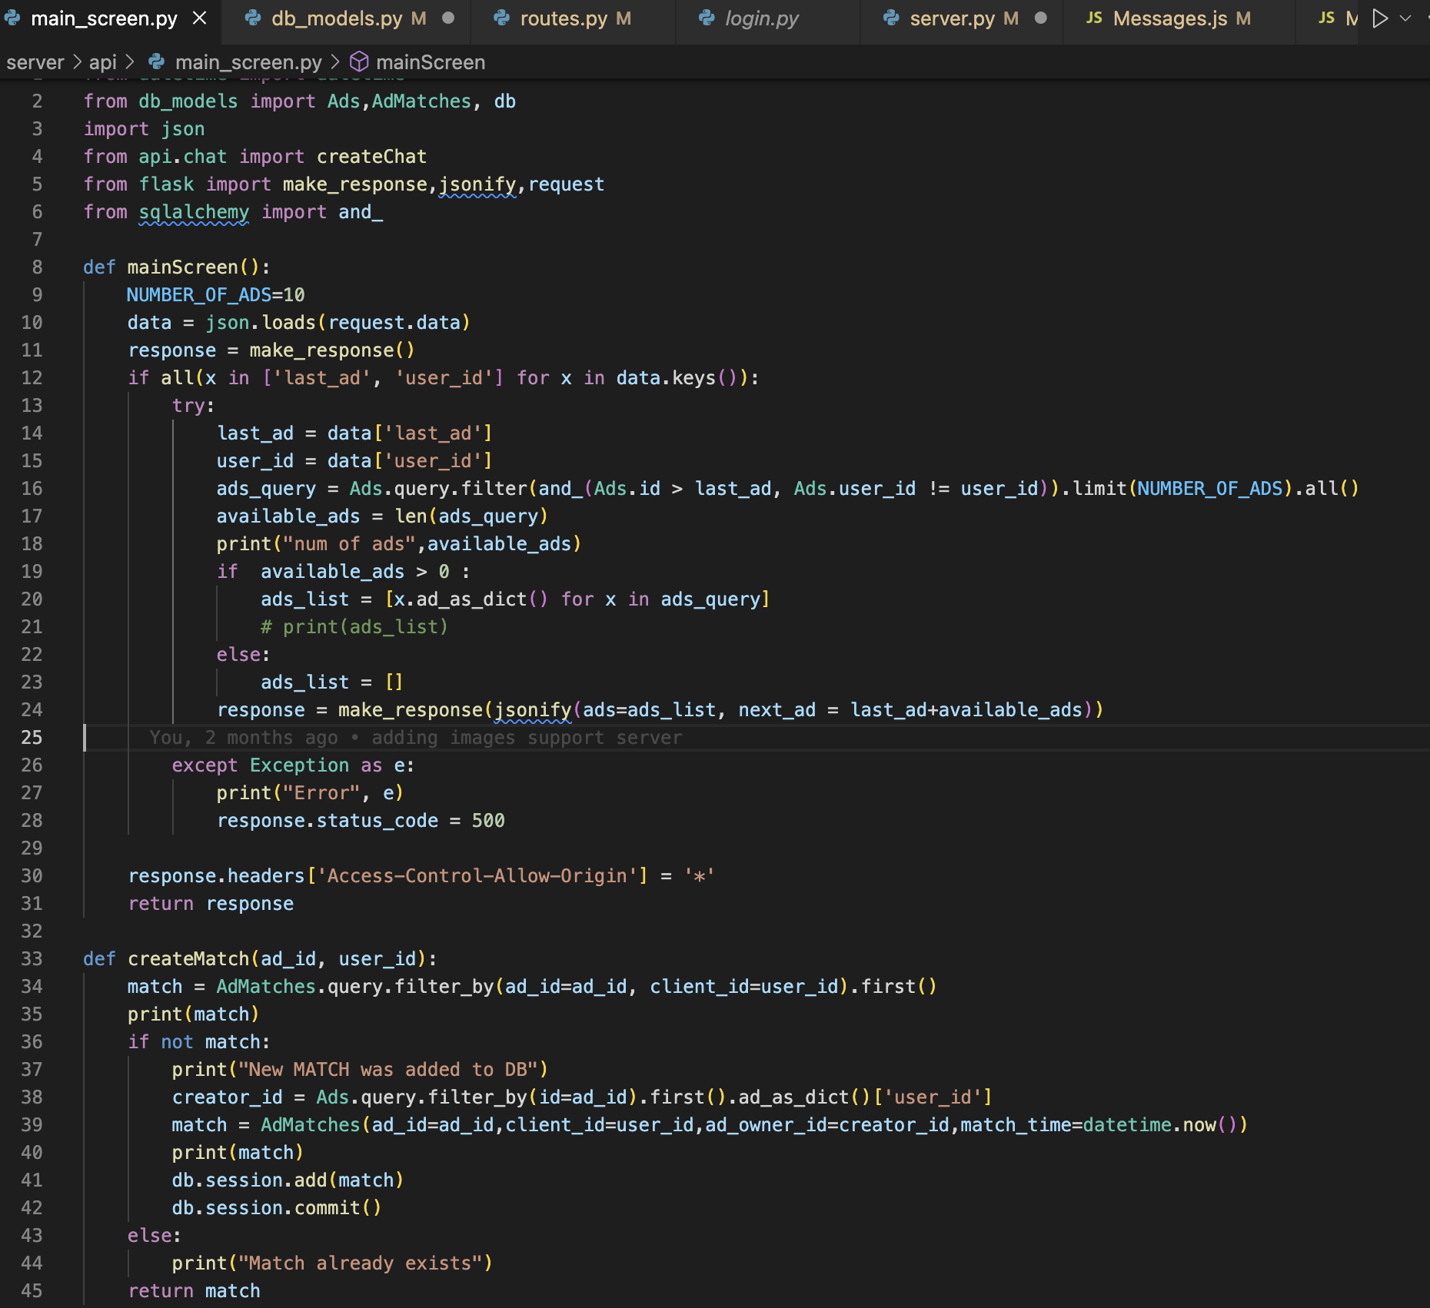
API
Our application has a clear logic separation between different features, each feature has a file with its different APIs. Each function register to a route by using Blueprint lib

Slide 17
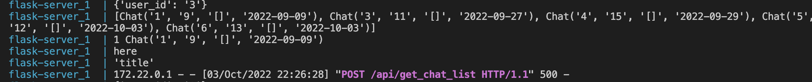
Successfully API call - 200
Unsuccessful API call -500

Slide 18
Thank you

